Slide 1
Multi-Agent System for Smart Traffic Management
By
Venkatesh Appala

Slide 2
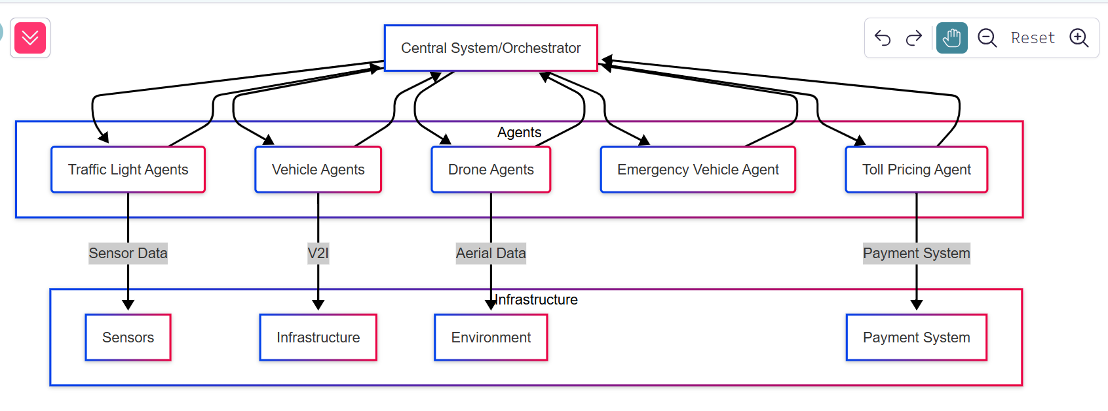
System Design Diagram
Notes:
Central System/Orchestrator: The core of the system, managing communication and coordination.
Agents: Individual entities with specific roles (traffic lights, vehicles, drones, etc.).
Infrastructure: External components like sensors, road networks, and payment systems.
Arrows: Represent data flow and communication.

Slide 3
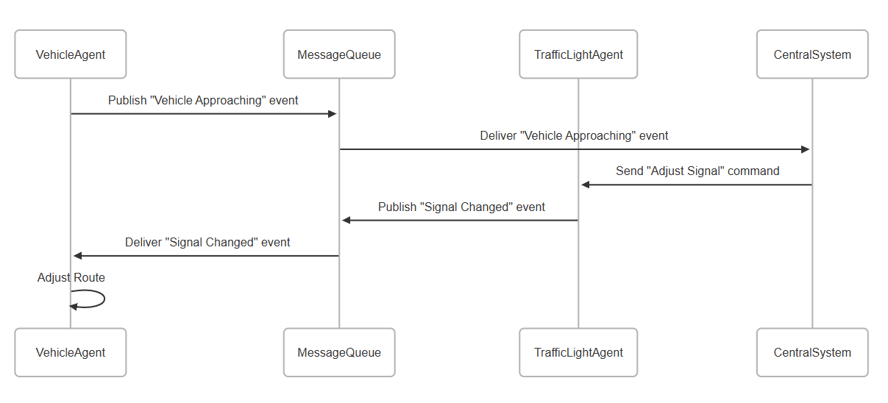
Event-Driven Communication Diagram
Notes:
Sequence Diagram: Shows the order of interactions.
Message Queue: Facilitates asynchronous communication.
Events: Messages that trigger actions in other agents.

Slide 4
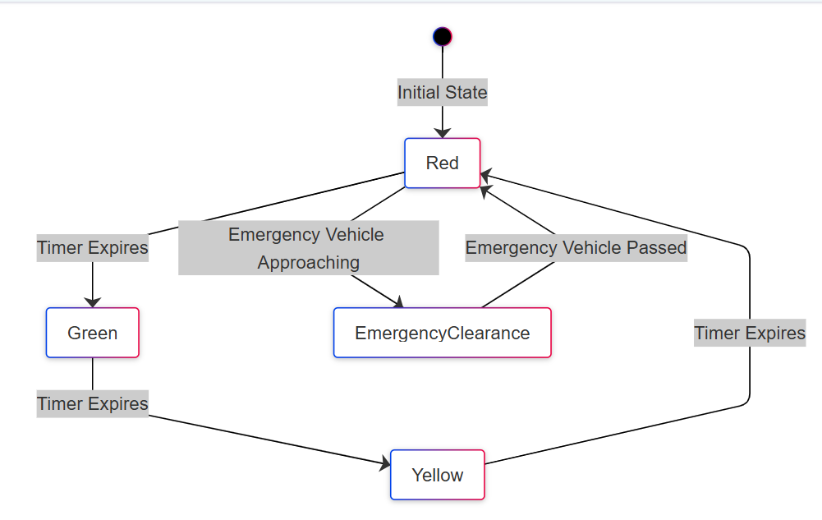
Traffic Light Agent State Diagram
Notes:
State Diagram: Shows the possible states and transitions.
States: Red, Green, Yellow, EmergencyClearance.
Transitions: Triggered by timers or external events

Slide 5
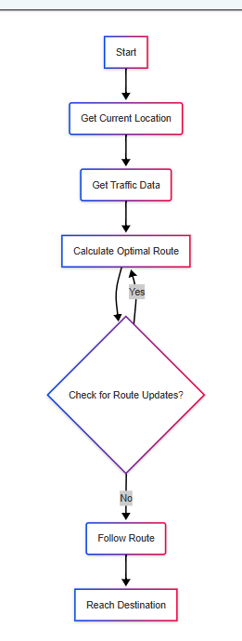
Vehicle Agent Routing Diagram
Notes:
Flowchart: Shows the steps involved in route calculation.
A* Algorithm: An example of a routing algorithm.
Route Updates: Real-time traffic information can change the route.

Slide 6
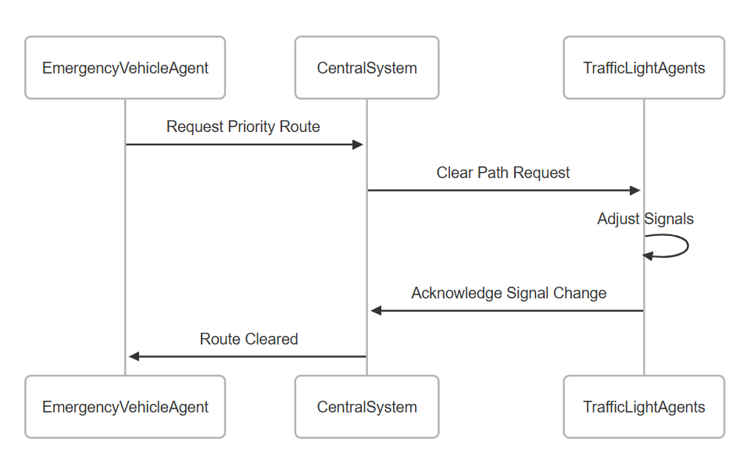
Emergency Vehicle Prioritization Diagram
Notes:
Emergency Vehicle Agent: Requests priority.
Central System: Coordinates the path clearing.
Traffic Light Agents: Adjust signals to create a clear path

